Slide 1

Chapter 13 Strategic Growth in Entrepreneurship

Slide 2


Slide 3
Five basic steps must be followed in strategic planning
Examine the internal and external environments of the venture (SWOT).
Formulate the venture’s long range and short range strategies:
Mission / objectives / strategies / policies.
Implement the strategic plan (Programs / budgets / procedures)
Evaluate the performance of the strategy.
Take follow up action through continuous feedback.

Slide 4
The lack of strategic planning (five reasons for the lack of strategic planning)
Time scarcity
Lack of knowledge.
Lack of expertise / skills.
Lack of trust and openness.
Perception of high cost.

Slide 5
Companies into the following categories
Category I
No written plan.
Category II
Moderately sophisticated planning.
Category III
Sophisticated planning.

Slide 6
5 fatal mistakes entrepreneurs make (fatal visions in strategic planning)
Fatal vision 1: misunderstanding industry attractiveness.
Fatal vision 2: no real competitive advantage.
Fatal vision 3: pursuing an unattainable competitive position.
Fatal vision 4: compromising strategy for growth.
Fatal vision 5: failure to explicitly communicate the venture’s strategy to employees.

Slide 7
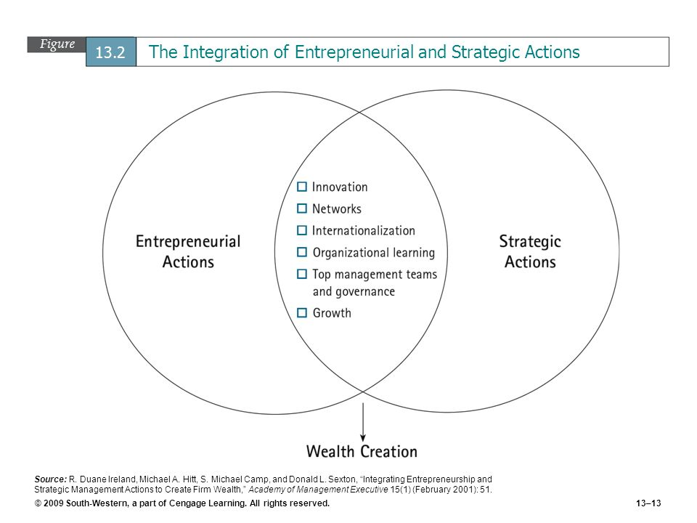

Slide 8
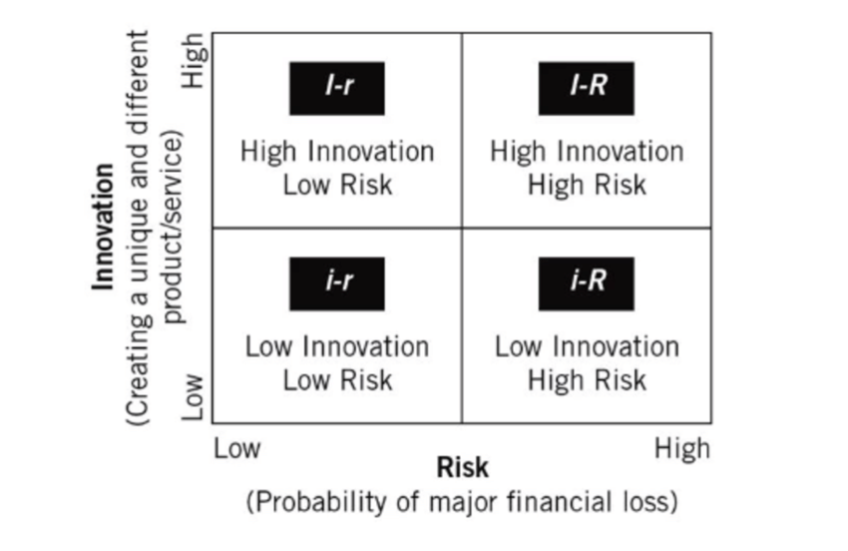
An entrepreneurial strategy matrix model

Slide 9
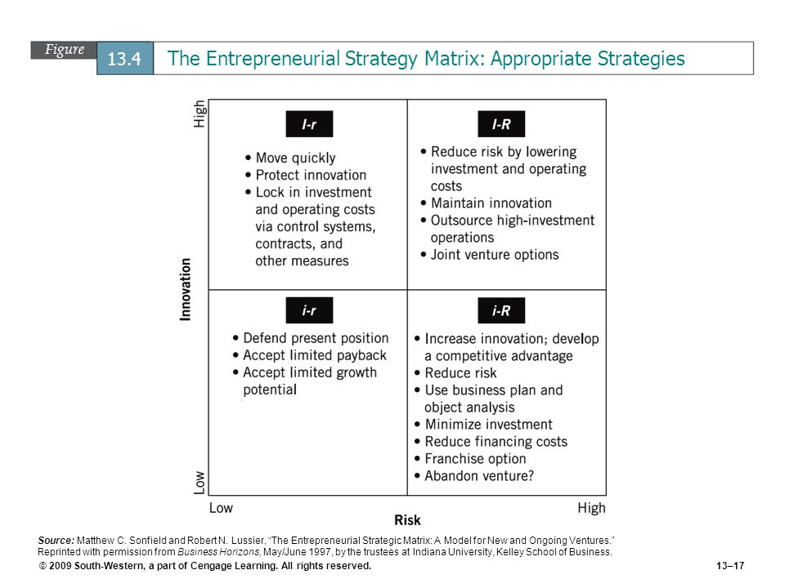

Slide 10
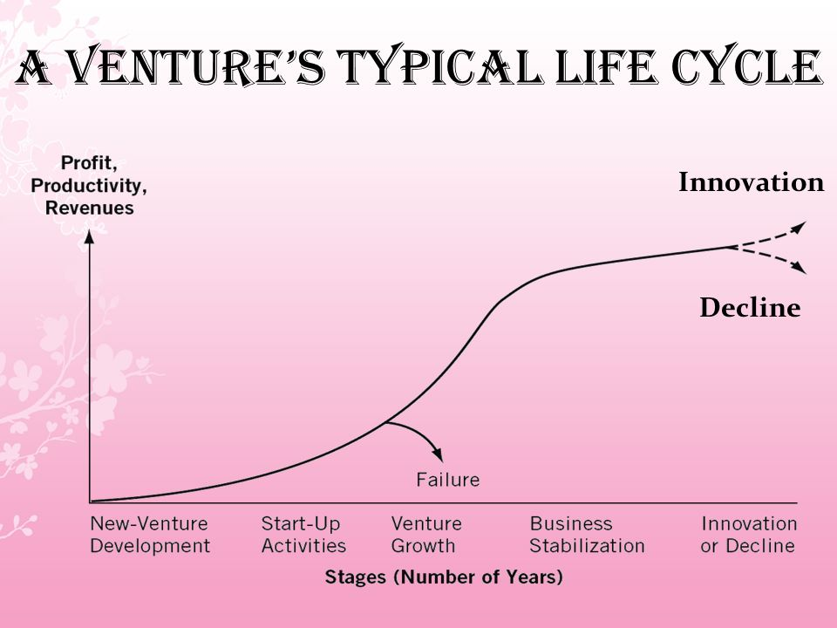

Slide 11
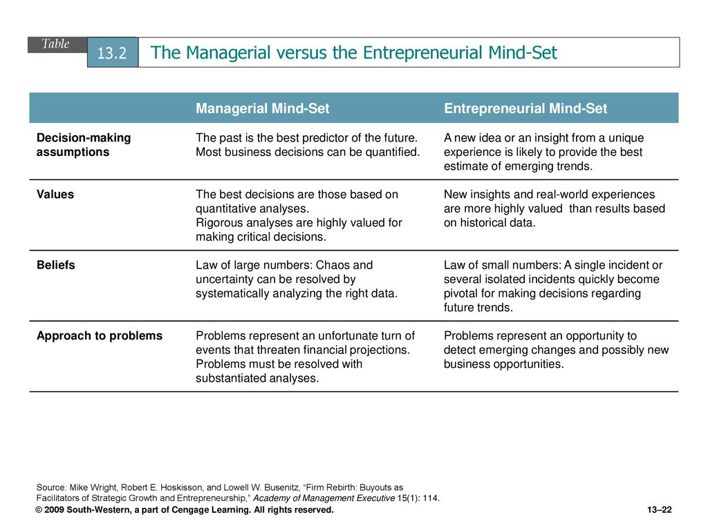

Slide 12
Balancing the focus – entrepreneurial versus managerial
The entrepreneur’s point of view
Where is the opportunity?
How do I capitalize on it?
What resources do I need?
How do I gain control over them?
What structure is best?
The administrative point of view
What resources do I control?
What structure determines our organization’s relationship to its market?
How can I minimize the impact of others on my ability in perform?
What opportunity is appropriate?

Slide 13
Unique Managerial Concerns of Growing Ventures (Emerging businesses differ in many ways from larger, more structured businesses)
The distinctiveness of Size
Small size organizations (Disadvantages)
Limits company’s ability to expand geographically.
Higher ordering cost to execute big orders.
Do not receive quantity discounts from suppliers.
Small size organizations (Advantages)
Greater flexibility
Decisions could be executed immediately
The one person band syndrome (one man show)
Time management
Assessment / prioritization / creation of procedures / Delegation
Community pressures (participation / leadership / donation)
Continuous learning

Slide 14
The Difficulty of Growth at Microsoft (page 1 of 3)
When a company gets as large as Mircrosoft, continuing to grow that company can prove difficult. Microsoft has benefited from selling the most widely used operating system and office productivity suite, which has resulted in its fortified position for the last two decades. Microsoft has been able to continue its strategy of evolutionary changes to Microsoft Windows and Microsofit Office, which primarily consisted of adding features to necessitate that its customers pay for upgrades.
This model proved effective for Microsoft until it brought its most recent operation system ‘ called Vista – to market. For the first time in the company’s history, its customers demanded that computer manufacturer such as Dell, which had begun shipping computers with Vista, return to providing XP, the preceding operation System, as an option. Clearly, Microsoft’s strategy was no longer going to provide the growth that it had once enjoyed.
Microsoft will not be shutting down any time soon, given that it generated net profits of $14 billion in 2007. Yet, outside of the lackluster sales of Vista, the company is facing some significant hurdles . The first of these is Google, which is by far the largest threat to Microsoft’s technical dominance. Google has slowly encroached on Microsoft’s territory, but Mircrosoft’s core products have remained insulated. As more software become freely available via the internet, Mircrosoft has been forced to recognize that its revenue model of charging licensing fees may no longer be viable.

Slide 15
The Difficulty of Growth at Microsoft (page 2 of 3)
The difficulty for Microsoft in taking the approach that Google has taken is that is requires it to recreates its culture. Whan an organization has operation for more than 30 years by changing its customers for its products, restructuring the company to focus on ways in which customers can instead receive products for free by generating advertising revenue is no easy task. Microsoft’s early attempts at building an online advertising business have not proven effective, which partly explains its recent $44 billion bid for Yahoo. By acquiring Yahoo, Microsoft would gain a company already familiar with building a Web based business and generating revenue through advertising.
In 2005, Ray Ozzie – one of the creators of Lotus Notes – a popular e-mail client – was brought into Microsoft as one of three Chief Technology Officers. His addition to Microsoft’s executive team was touted as a major coup for the company and a clear indication of its commitment to being proactive as the market shifted to an open source platform. In June 2006, Ozzzie took over as Microsoft’s chief software architect, a position previously held by Bill Gates. Shorty thereafter, the company announced a historic partnership with Novell that would make Microsoft’s products more compatible with Novell’s open source SUSE Linux software. Ironically, Microsoft, discovered that it sold more products when it allowed Windows to operate freely with Linux.

Slide 16
The Difficulty of Growth at Microsoft (page 3 of 3)
The reality is that Microsoft has not willingly transitioned to a new model. In fact, the company’s top management was reported comparing open source software to socialism; yet with its recent strategic decisions, Microsoft has revealed that it has decided to embrace rather than fight with the market has been indicating for several years, which is that its old business model will no longer be effective. Ozzie has been given the daunting task of “Webifying” everything Microsoft has to offer, from its business and consumer software to its Xbox gaming systems.
The company appears to be further plagued by the departures of its long-time CEO Bill Gates, who plans to transition to part-time chairman of the board. When Microsoft recently announced that it was promoting greater interoperability, Gates did not participate. Some analyst would point to Gates’ departure as a sure sign of more trouble ahead for Microsoft; however, others have argued that Gates is ill equipped to take the company where it needs to go, which is an important consideration for all entrepreneurs. No matter how successful a company becomes, it has to be willing to change to continue to grow. If current management cannot make the transition, they have to be willing to allow those who can to take over.

Slide 17
From Entrepreneur to Manager (for many entrepreneurs, one of the most difficult tasks is to make the successful transition from a creative, task juggling entrepreneur to a business-skill-applying manager)
Don’t be the company handyperson (when grown then delegate)
Hire to your shortcomings (hire others to complement knowledge gap)
Don’t over hire.
Call out the “SWOT” team (SWOT meetings – open mindedness)
Give employees a stake in the company’s success.
Hold down expenses.
Go Global.
Scratch the customer’s itch.
Adapt to change.
Seek customer advice.
Sniff out the silver linings (look for opportunity in the face of adversity)

Slide 18


